Slide 1
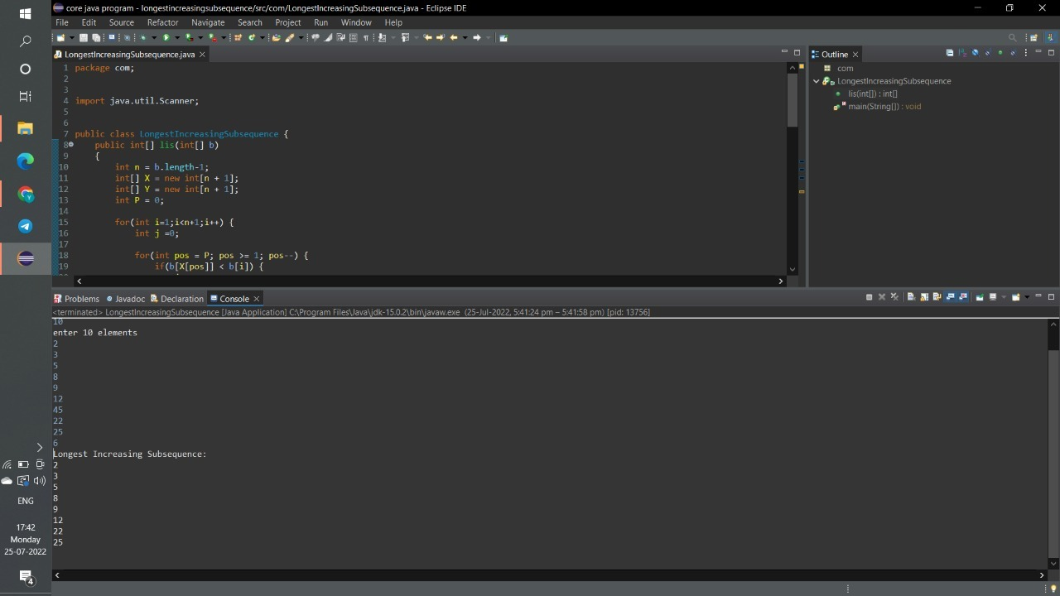
LONGEST INCREASE SUBSEQUENCE OUTPUT SCREENSHOTS

Slide 2
